Slide 1
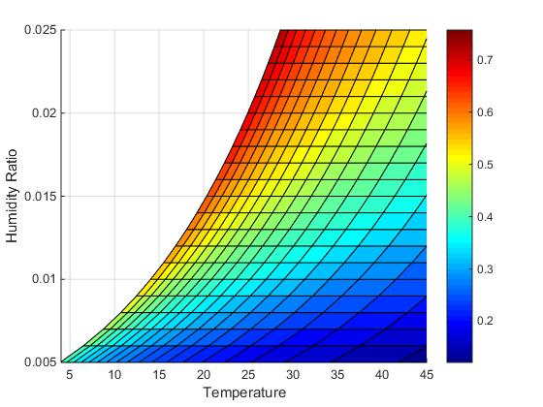
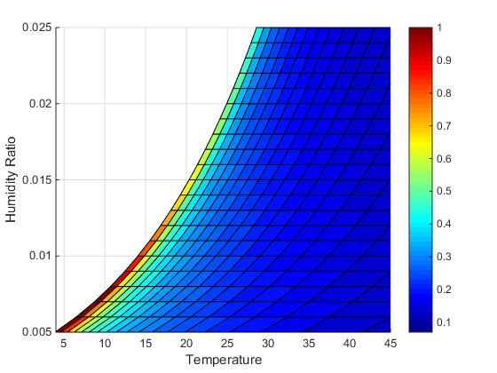
Simple System
Colorbar: MHI Colorbar: Mass Flow Rate (in kg/s)

Slide 2
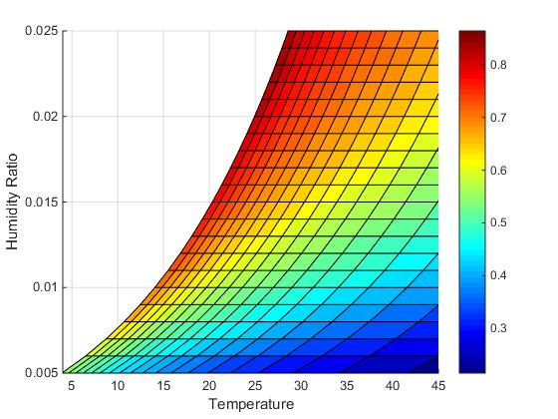
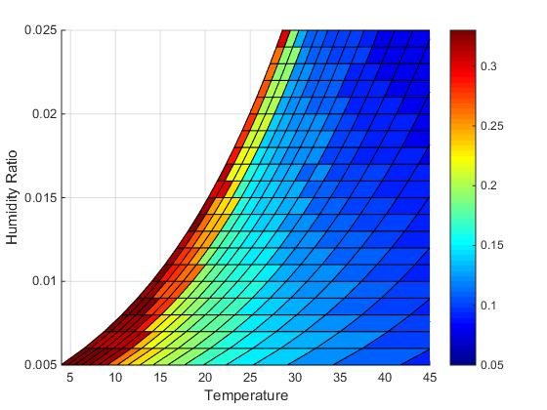
Optimized System
Colorbar: MHI Colorbar: Mass Flow Rate(in kg/s)

